Slide 1
Physics 1 – Jan 6, 2017
P3 Challenge–
  An acorn falls from a 3.2 m high branch. Use energy methods to determine the speed of the acorn when it hits the ground below?
Today’s Objective: Power
Assignment:
  Conservation of Energy Worksheet, p3
  Start studying for Test on Tues Jan 17
Agenda
  Power
  Efficiency
  Homework Review

Slide 2
When there is friction….
Friction is a nonconservative force that does negative work on a system.
The change in energy of the system E = W is equal to the work done by friction. Or E_{k1} + E_{P1} + W_{nc} = E_{K2} + E_{P2}
Ex: A 62.9-kg downhill skier is moving with a speed of 12.9 m/s as he starts his descent from a level plateau at 123-m height to the ground below. The slope has an angle of 14.1 degrees and a coefficient of friction of 0.121. The skier coasts the entire descent without using his poles; upon reaching the bottom he continues to coast to a stop; the coefficient of friction along the level surface is 0.623. How far will he coast along the level area at the bottom of the slope? (Use energy methods)

Slide 3
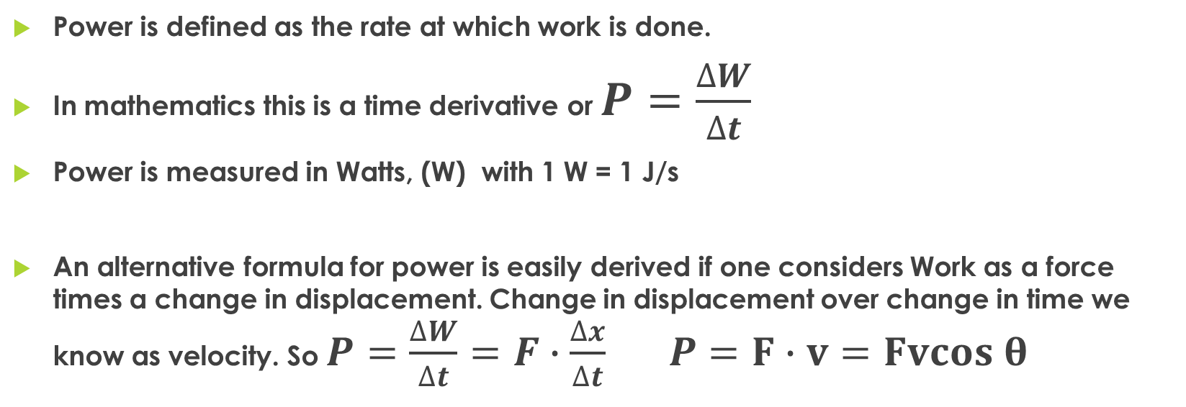
Power
Power is defined as the rate at which work is done.
In mathematics this is a time derivative or $P=\frac{∆W}{∆t}$
Power is measured in Watts, (W) with 1 W = 1 J/s
An alternative formula for power is easily derived if one considers Work as a force times a change in displacement. Change in displacement over change in time we know as velocity. So $P=\frac{∆W}{∆t}=F∙\frac{∆x}{∆t} P=F∙v=Fvcos θ$

Slide 4
Power problems
Ex: Running late to class, Jerome runs up the stairs, elevating his 102 kg body a vertical distance of 2.29 meters in a time of 1.32 seconds at a constant speed. What power did Jerome generate?
Ex: At what velocity is a car moving at the instant its engine is using 2,250 watts to exert 130 N of force on the car’s wheels?

Slide 5
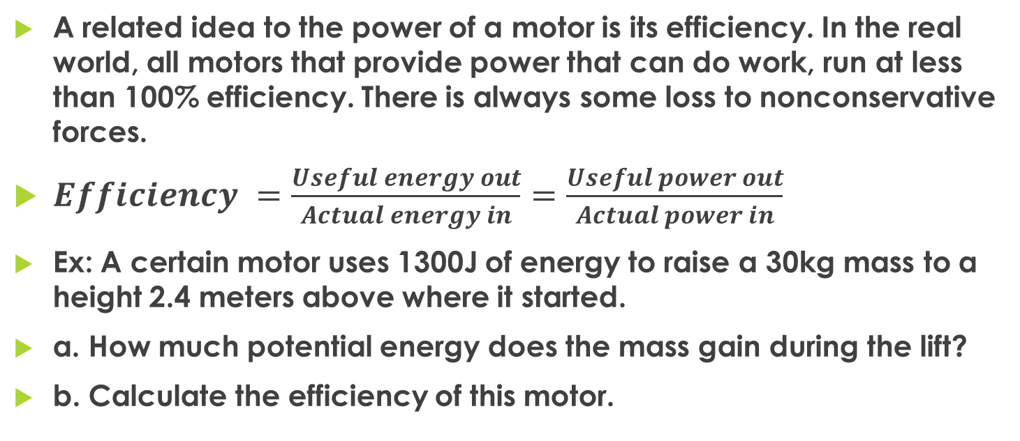
Efficiency
A related idea to the power of a motor is its efficiency. In the real world, all motors that provide power that can do work, run at less than 100% efficiency. There is always some loss to nonconservative forces.
$Efficiency =\frac{Useful energy out}{Actual energy in}=\frac{Useful power out}{Actual power in}$
Ex: A certain motor uses 1300J of energy to raise a 30kg mass to a height 2.4 meters above where it started.
a. How much potential energy does the mass gain during the lift?
b. Calculate the efficiency of this motor.

Slide 6
Exit Slip - Assignment
Exit Slip- An elevator has a mass of 4500 kg and is carrying a load of 1800 kg. If the cab is moving upward at 3.80 m/s, what power is required of the elevator motor to maintain that speed?
What’s Due on Jan 10? (Pending assignments to complete.)
  Conservation of Energy Worksheet (page 3)
What’s Next? (How to prepare for the next day)
  Read 2.3 p78-95 about Work and Energy

